Slide 1
COFFEE SHOP IN TORONTO ?

Slide 2
Business Problem
Coffee is a part of Canadians daily routine.Canada also has many coffee shops.But it doesnot mean that there is no possibility of starting up a new one.
Moreover starting a coffee shop in Toronto will definitely work as people love coffee but we should find a proper location.
Objective : To find the possible locations in the neighbourhoods of Toronto to open a new Café based on population and density.
Business question : In the neighbourhoods of Toronto, where an entrepreneur can start a new Coffee brand or a franchise to enjoy competitive advantage?

Slide 3
Data Acquisition
Data Required
List of neighbourhoods in Toronto
Demographic data of Toronto neighbourhoods
Latitude and longitude coordinates of the neighbourhoods
Venue data, particularly data related to coffee shops
Sources of data
Wikipedia page for neighbourhoods (List of postal codes of Canada)
Wikipedia page for demographic data (Demographics of Toronto neighbourhoods)
Geocoder package for latitude and longitude coordinates
Foursquare API for venue data

Slide 4
Methodology
Web scraping wikipedia pages for neighbourhoods list and for demographic data
Get latitude and longitude coordinates using Geocoder
Use Foursquare API to get venue data
Clean, merge, concatenate, transform and select features for analysis
Perform clustering on the Café data by using k-means clustering by finding the best k which is 6 in my project
Visualize the clusters in a map using Folium
Examine clusters and visualize population, density and coffee shop data in each neighbourhood using a bar graph

Slide 5
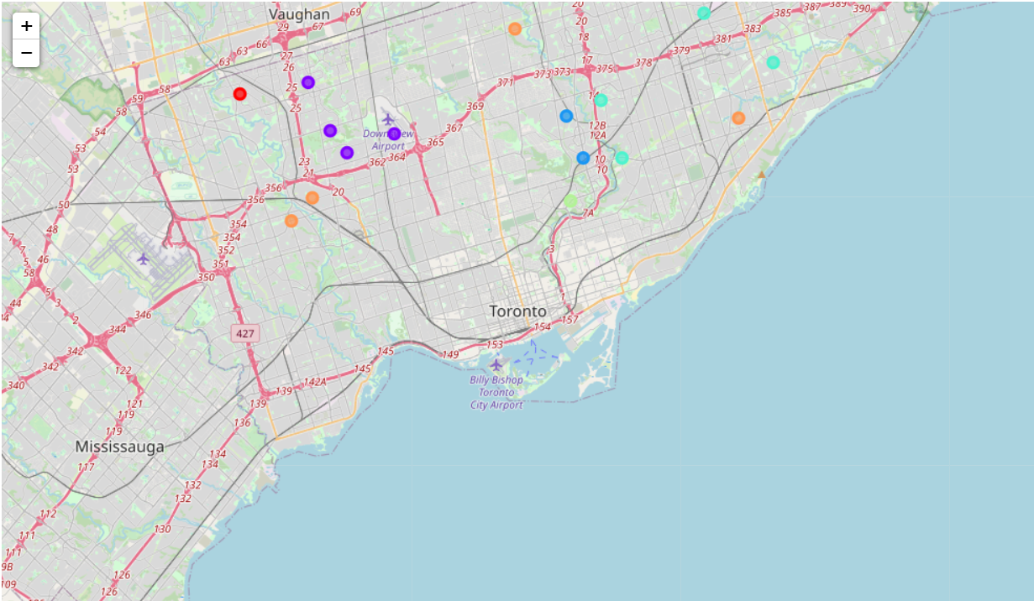
Results
Categorized the neighbourhoods into 6 clusters

Slide 6
Discussion
Cluster 1 : It has very low coffee shops as per population.So, Coffee Shop can be started in Humber Summit
Cluster 2 : It has large number of Coffee Shops.So, there is no possibility of starting one more
Cluster 3 : It has many Coffee Shops which can serve the population of the neighbourhoods so, no possibility for one more
Cluster 4 : It has less Coffee Shops. As density is high although population is low in Parkwoods , Victoria Village and the Woburn has high population, a new Coffee Shop can be started

Slide 7
Cluster 5 : Although population is less in Thorncliffe Park, density is high. So, Coffee Shop can be started
Cluster 6 : Scarborough Village, Weston, Westmount have high density compared to population. BayView has enough number of Coffee Shops. Agincourt has high population and comparable density. So, Coffee Shop can be started in ScarboroughVillage, Weston, Westmount and also Agincourt

Slide 8
Conclusion
In this study, I used clusters to find locations where I can start up a Coffee Shop based on population and density of neighbourhoods. After examining all the clusters, few locations are suitable to start Café.They are Humber Summit, Parkwoods, Victoria Village, Woburn, Thorncliffe Park, Scarborough Village, Weston, Westmount, BayView and Agincourt

Slide 9
THANK YOU!

